Slide 1
Data-Driven Health Insurance Upsell with Machine Learning
​

Slide 2
MEET OUR TEAM
Raghavendra
SURYA MANJRI
Gowtham Reddy
Hemanth
​
Team Leader
Team Member
Team Member
Team Member

Slide 3

BUSINESS objective
A financial service provider has introduced a new policy and aims to upsell health insurance to their existing customers by predicting customer interest based on demographics and policy information.

Slide 4
Proposed Solution
This project will have a machine learning model that can predict customers interested in health insurance. It'll help the team to select the best customers that may be interested in health insurance.

Slide 5
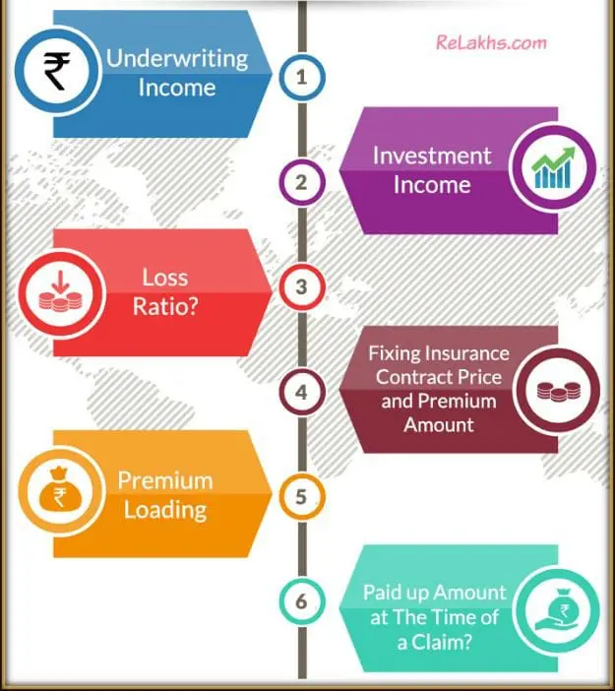
Business Model of A financial Insurance Company
Underwriting Income: The amount of money received from premiums after underwriting expenses are subtracted.
Investment Income: The money received from investments made with premiums.
Loss Ratio: The proportion of actual losses to premium income.
Insurance Contract Price and Premium Amount: Determining the insurance policy's premium amount by taking into account a number of risk factors.
Premium Loading and Paid-Up Amount at the Time of a Claim: An extra charge added to the premium to cover costs, and the sum disbursed in the event that a claim is approved.

Slide 6

CRISP DM METHODOLOGY

Slide 7


BUSINESS UNDERSTANDING
To properly analyze the data and pose business-related
queries about it, we should possess a fundamental
understanding of business within our domain.
For example, our question could be: In what ways will the
company customize their health insurance upselling
approach based on customer demographics?
What particular information about the consumer base
or data points will the company utilize to forecast interest
in the new health insurance policy?

Slide 8

DATA UNDERSTANDING
In this stage, we locate, gather, and examine the datasets that can support the accomplishment of our project objectives.
The dataset will be acquired from Kaggle.
01
02
AGE, PROPOSED PLAN, HEALTH ISSUES, and DECISION are the key values required to accomplish our project.

Slide 9


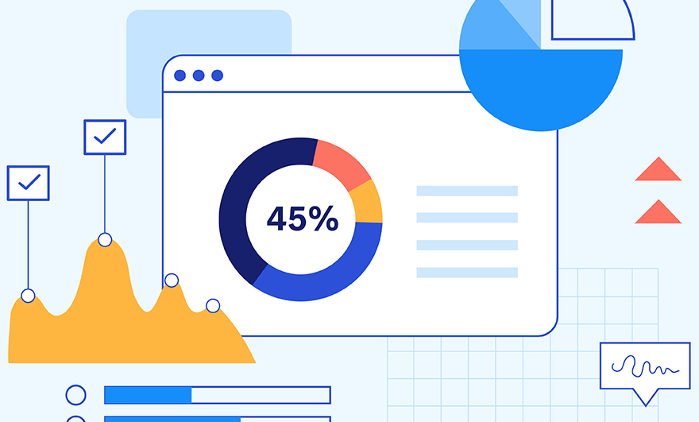









FURTHER PROCESS PLAN
DATA
CLEANING
DATA
MODELING
DATA
VISUALIZATION
DEPLOYMENT

Slide 10
FUTURE APPROACH
Customer Satisfaction and Feedback
• Analyze customer feedback, complaints, and satisfaction surveys to understand policyholders' experiences. Which will help the company to bring the new customers to policy.

Slide 11
THANK YOU

